Slide 1
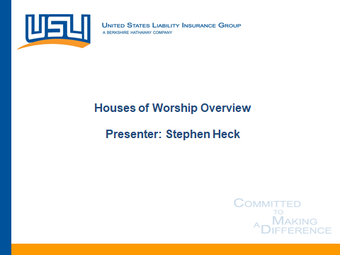

Tis’ The Season For Nonprofit Opportunities!
Denise Browne, Business Development Manager
Jessica Knopp, Social Service Product Leader & Nonprofit Assistant Team Leader
Kristina Maruszczak, Nonprofit Package Underwriter
Brian Smith, East Regional Team Leader
Katie Taraborrelli, Instant Quote Marketing Team Leader

Slide 2
Agenda
The Nonprofit Opportunity
Nonprofit Package Products
Social Service Organizations
Sports Teams, Leagues, Camps
Instant Quote Demonstration
Questions

Slide 3
Why Target This Segment?
Size: There are 2.8 million nonprofit entities in the U.S.
Stability: The sector shows steady growth year after year
Responsibility: Nonprofit structure requires transparency and they need to be budget-oriented
Identifiable: Very easy to find and build leads
Complex: They have a wide variety of exposures
Differentiation: Specialization allows you to tell a different story from your competition

Slide 4
Nonprofit by Revenue
2.8 million nonprofits in total
This section alone represents a
$3.5 billion market, or 1.8 Million nonprofits. Our Package products are priced effectively for even the smallest nonprofits!

Slide 5
Lines of Coverage
General Liability
Hired & Nonowned Auto
Abuse & Molestation
Errors & Omissions
Property
Directors & Officers Liability
Employment Practices
Umbrella & Excess
Blanket Special Event endorsement
  General Liability and host liquor with options to upgrade for commercial exposures
  Reduces gaps, costs, and headaches

Slide 6












Portfolio of Products
Arts and Culture
Business Associations
Charities
Community Associations
Houses of Worship
Nonprofit Excess Liability
Nonprofit Umbrella Liability
Premises Preferred
Special Events
Social Services
Social Clubs
Sports Advantage
Our products cover over 500 classes of nonprofit organizations

Slide 7

Social Service Product
Food banks & soup kitchens
Thrift stores
Residential (adult shelters, halfway houses, homeless shelters)
Counseling (substance abuse, anger management, mental health, and animal therapy)
Youth and senior outreach (community centers, after-school programs, mentoring, STEM programs, caregivers, Meals on Wheels)
& so much more!

Slide 8
Social Service Product Advantages
Low minimum premium of $500/$735
General Liability/Professional Liability/Abuse & Molestation
Special events automatically included for up to 1,000 attendees
Hired and non-owned auto for client transport
Management/Employment practices liability can be added with separate limits on claims-made basis

Slide 9

Sports Advantage
Baseball
Bowling
Cross Country
Flag Football
Lacrosse
Racquetball
Soccer
Swimming
Volleyball
Tennis and more!

Slide 10
Sports Advantage Product Advantages
Coverage for Teams, Leagues, Camps, Clinics, Associations
Youth and Adult Sports
Participant Coverage is available for youth organizations
Abuse & Molestation limits of $100,000/$200,000 included with the option to increase to $1M
Assault or Battery sublimit of $50,000 at no additional charge
No Designated Premise Limitation – fundraisers and special events included
Ability to provide inland marine on a scheduled or blanket basis up to $500,000

Slide 11
The Time Is Now
How to get a quote – you have options!
Phone: Call 888-845-6104 for an instant quote right over the phone
Web: https://www.arlingtonroe.com/online-rating/
Reach out to Arlington/Roe to speak to an underwriter: Call 800-878-9891

Slide 12
Moving Forward
Thank you for your time!
Questions and answers

